Slide 1
Computer Architecture I
ECE-GY-6913
Topic: Introduction and Instruction Set Architectures (ISA)
Instructor: Siddharth Garg

Slide 2
Logistics and Syllabus
Please refer to the online syllabus on NYU Classes for details on the course policies, grading scheme, schedule etc .

Slide 3
Plagiarism
Why not?
You won’t learn much
You’ll likely get caught
What happens if I get caught?
Automatic zero on assignment and grade reduction
Second strike and you fail the class
Don’t do it
Don’t do it
Don’t do it
Don’t do it
Don’t do it
Don’t do it
Don’t do it
Don’t do it

Slide 4


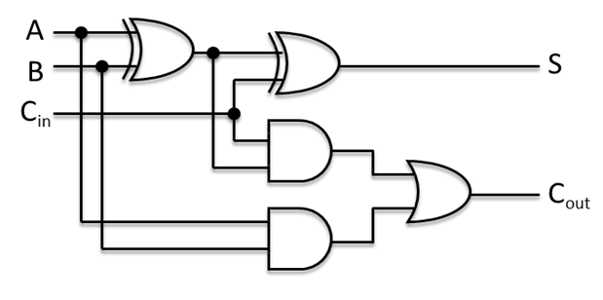
Introduction
Step-by-step set of operations to solve a certain problem
Algorithm
Examples: C/C++, Java, Python etc.
Problem-oriented Programming Language
Compiler
Step-by-step instructions that your computer can understand!
Instruction Set Architecture (ISA)
Examples: …….?
Assembly Language
Computer Architecture
Micro-architecture
Hardware-level description of how processor executes ISA
Many different ways of executing the same ISA
Examples: …….?
Digital Logic/Hardware
Boolean logic gates, flip-flops/registers

Slide 5
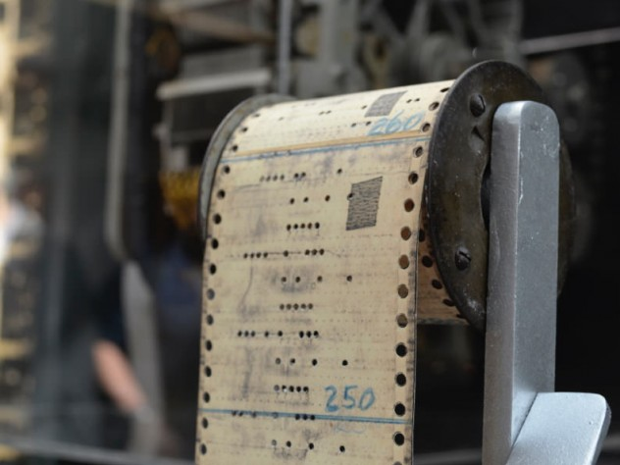

Historical Perspective: Harvard Mark I
60 “constant registers” (23 decimals + sign)
Manually programmed constants
72 “storage counters” (23 decimals + sign)
To hold intermediate results of computation
Instruction Format
24 “bits”
Fed with punch card
“Harvard Architecture” - separate memory for instructions and data
OUT (operand) | IN (operand, result stored here) | MISC. (which operation is performed)
Storage Counter 1 (Decimal Code: 1) | Storage Counter 2 (Decimal Code: 2) | SUB (Decimal Code: 32)
$$SC2 ←SC2−SC1$$
No branch instructions!

Slide 6
EDVAC: Electronic Discrete Variable Automatic Computer
Internal magnetic “tape” based memory consisting of 1024 44-bit words
Digital (0,1) instead of decimal (0,1,2,..9) representation
Each word could represent either data or an instruction
Up to 16 different instructions, including branch instructions
Von Neumann Architecture: Unified memory for data and instructions
Op Code (4 bits) | OP 1 (10 bits) | OP 2 (10 bits) | OP 3 (10 bits) | Next Instruction
Which operation (add, sub, mult, branch…) | Address of 1st operand | Address of 2nd operands | Address where result stored | Address from where next instruction fetched

Slide 7
Harvard Vs. Von Neumann Architecture
Harvard
Von Neumann
Central Processing Unit (CPU)
Central Processing Unit (CPU)
Inst. Memory
Data Memory
Data + Instruction Memory
Data memory must be a RAM (random access memory) with read/write capability
Instruction memory can be a ROM (read only memory)
Memory must be a RAM (random access memory) with read/write capability

Slide 8
Harvard Vs. Von Neumann: Pros/Cons
Discuss: Pros vs cons of Harvard vs. Von Neumann architecture
Harvard Architecture
Con: dedicated memory for code results in inefficient use of memory capacity
Pro: Code memory can be read only (faster, smaller, cheaper)
Pro: code is protected
Von Neumann Architecture
Pro: flexible use of available memory capacity
Con: Memory needs to support read/write
Con: code can be maliciously re-written
Notes:
Dedicated code memory wastes space, self-modifying code; security analysis; faster Rom

Slide 9
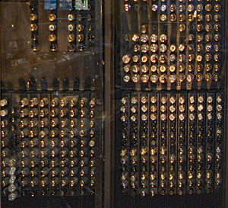
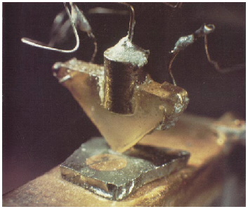
Invention of the Transistor
ENIAC had 18000 vacuum tubes and consumed 150 kW of power
Vacuum tubes ruled in first half of 20th century Large, expensive, power-hungry, unreliable
1947: first solid-state transistor
John Bardeen and Walter Brattain at Bell Labs
AT&T Archives. Reprinted with permission.

Slide 10
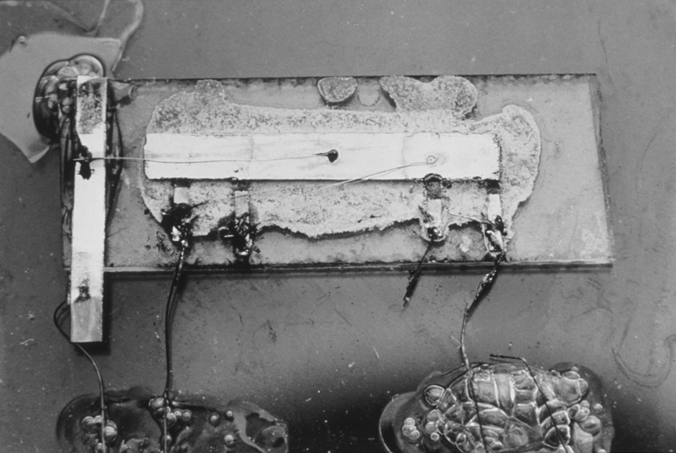
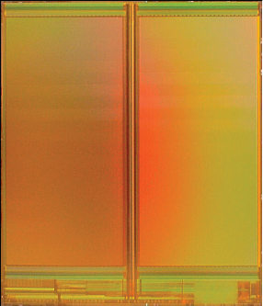
From Transistors to Integrated Circuits
1958: First integrated circuit
Flip-flop using two transistors
Built by Jack Kilby at Texas Instruments
2010
Intel Core i7 μprocessor
2.3 billion transistors
64 Gb Flash memory
> 16 billion transistors
Courtesy Texas Instruments
[Trinh09]
© 2009 IEEE

Slide 11
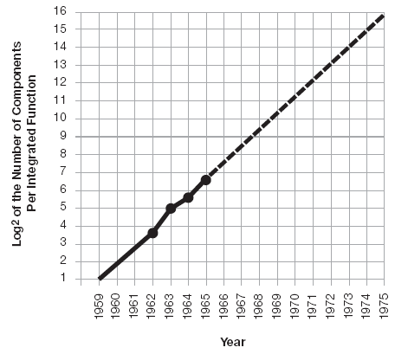
Moore’s Law: Then
1965: Gordon Moore plotted transistor on each chip
Fit straight line on semilog scale
Transistor counts have doubled every 26 months
Integration Levels
SSI: 10 gates
MSI: 1000 gates
LSI: 10,000 gates
VLSI: > 10k gates
[Moore65]
Electronics Magazine

Slide 12
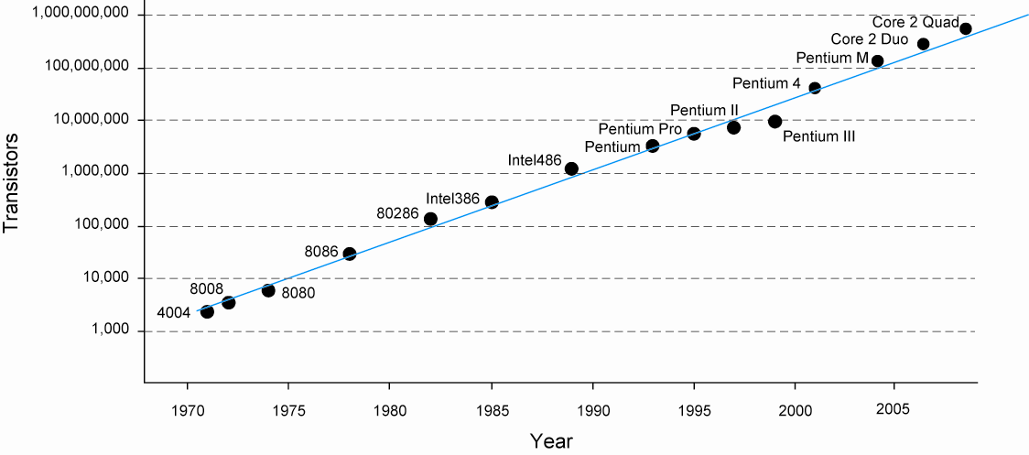
And Now…

Slide 13
Modern Computers
Fast local access to data. Based on idea of temporal locality: frequent reuse of data fetched from memory
Central Processing Unit (CPU)
Datapath
Register File
byte 1
Reg. 1
byte 2
Unified: stores both instructions and data
Random access: CPU can read/write any byte of data
+
X
Reg. 2
Adders, multipliers etc.
Reg. M
Array of Bytes
Memory Controller
Control
Path
PC
byte N
Main Memory
Instructions are in processed sequentially (one after the other). Address of current instruction stored in Program counter (PC)
Handles read/write requests from CPU to main memory
CPU PC, registers, Datapath, control path, unified main memory, caches, Disk, I/O

Slide 14
How is Main Memory Accessed
Each byte of data in a “byte addressable” main memory has a unique address
Central Processing Unit (CPU)
How many bits should Addr have?
Main Memory
Datapath
Register File
Reg. 1
byte 1
“Byte addressable”
Addr
byte 2
+
X
Reg. 2
Reg. M
Memory Controller
Array of Bytes
Mem[Addr]
Control
Path
PC
byte N
{Mem[Addr], Mem[Addr+1], Mem[Addr+2], Mem[Addr+3]}
A “word” (example 4 bytes) of data can be fetched by issuing multiple read commands

Slide 15
Role of the ISA
Instruction Set Architecture (ISA) serves as a contract between programmer and hardware
Functional description of storage locations and the operations it can perform
Storage locations:
Registers: typically a small number of registers. Ex: MIPS ISA defines 32 32-bit registers.
Memory: much larger, but off-chip and higher access cost. MIPS ISA has a 32-bit memory address, so in theory 2³² Bytes = 4GB of data.
Operations:
Integer Add, Integer Multiply, Branch, FP Add, FP Multiply, FP Divide

Slide 16










ISAs are Abundant
T32 (Thumb)
A32 (ARM)
A64 (ARM-64)
Laptop
Desktop
Laptop
Desktop
x86
x86-64
IA64
x86
x86-64 (AMD64)
MIPS32
MIPS64
Mobile
Embedded
SPARC
Servers
IBM360
VAX
Servers
PowerPC
Alpha
Servers
Laptop
Desktop

Slide 17
MIPS ISA Overview
https://inst.eecs.berkeley.edu/~cs61c/resources/MIPS_Green_Sheet.pdf
32-bit ISA (what does this mean?)
Instruction length: 32 bits
Data word length: 32 bits
Main memory address: 32 bits
32 general purpose registers ($0, $1, $2, … $31); 32-bits each
Register $0 is hard-wired to 0 (constant)
All other registers can be used as read/write
Two dedicated 32-bit registers hi and lo for multiplication ops
Separate regs/unit for floating point ops (discussed later)
Byte addressable main memory
32-bit addresses => 2³² Bytes = 4GB of main memory

Slide 18
MIPS Instructions: R-Type
31
26
25
21
20
16
15
11
10
6
5
0
Op-code
(6-bits)
Rs
(5-bits)
Rt
(5-bits)
Rd
(5-bits)
Shamt
(5-bits)
funct
(6-bits)
000000 for all R-type instructions
Operand register identifiers
Result register identifier
Shift amount
Add: 10 0000 = 20_{hex}
Sub: 10 0010 = 22_{hex}
Or: 10 0101 = 25_{hex}
Sll: 00 0000 = 00_{hex}
add rs, rt, rd // R[rd] ← R[rs] + R[rt]; signed addition; trap on overflow
sub rs, rt, rd // R[rd] ← R[rs] - R[rt]; signed subtraction; trap on overflow
or rs, rt, rd // R[rd] ← R[rs] | R[rt]; bit-wise Boolean OR operation
sll rt, rd, shamt // R[rd] ← R[rt] << shamt; logical shift left
…..(many others)

Slide 19
MIPS R-type Instructions: Add vs Addu
add rs, rt, rd // R[rd] ← R[rs] + R[rt]; signed addition; trap on overflow
rs, rt and rd are assumed to contain 32-bit signed, 2’s complement numbers
MSB (32nd bit) indicates if the number is positive or negative
Review 2’s complement representation (https://en.wikipedia.org/wiki/Two%27s_complement)
Example: assume only 4-bit numbers in range [-8,7]
rs = 0101 (5)
rt =+ 0110 (6)
rd= 1011 (-4) → Overflow!
addu rs, rt, rd // R[rd] ← R[rs] + R[rt];
NO trap on overflow

Slide 20
MIPS R-type Instructions: Mult
mult rs, rt // {hi,lo} ← R[rs] * R[rt]; signed multiplication
hi and lo are two special purpose 32-bit registers that store the result of a multiplication operation
Why? Multiplication result of two 32-bit values needs at least 64 bits
rs
rd
32-bits
32-bits
X
64-bits
{hi (upper 32-bits) , lo (lower 32-bits)}

Slide 21
MIPS Instructions: I-Type
31
26
25
21
20
16
15
0
Op-code
(6-bits)
Rs
(5-bits)
Rt
(5-bits)
Immediate
(16-bits)
addi: 8_{hex}
beq: 4_{hex}
ori: 25_{hex}
lw: 23_{hex}
Operand register
Result register
Immediate operand
(“PC relative”)
addi rs, rt, imm // R[rt] ← R[rs] + {SignExtend, imm}; MSB of imm is extended to 32 bits
ori rs, rt, imm // R[rt] ← R[rs] | {ZeroExtend, imm}; bit-wise Boolean OR operation
beq rs, rt, imm //if{R[rs] == R[rt]} branch to PC + 4 + BranchAddress; (“PC relative”)
//Else go to PC+4
//BranchAddress = {SignExtend, imm, 00}
lw rs, rt, imm // R[rt] ← Mem[ {SignExtend, imm} + R[rs] ] (“Displaced/based”)

Slide 22
MIPS Instructions: J-Type
31
26
25
0
Op-code
(6-bits)
address
(26-bits)
j: 2_{hex}
jal: 3_{hex}
Immediate operand
j address // PC ← JumpAddress
jal address // R[31] ← PC+8; PC ← Jumpaddress;
//JumpAddress = { PC+4[31:28], address, 2’b0 }
// Also, R-type jump
jr rs // PC ← R[rs]

Slide 23
ISAs are Abundant
RISC ISAs
T32 (Thumb)
A32 (ARM)
A64 (ARM-64)
Laptop
Desktop
Laptop
Desktop
x86
x86-64
IA64
x86
x86-64 (AMD64)
MIPS32
MIPS64
Mobile
Embedded
SPARC
Servers
IBM360
VAX
Servers
CISC
ISAs
PowerPC
Alpha
Servers
Laptop
Desktop

Slide 24
ISA Design: Instruction Length
An instruction is a basic unit of an ISA
Fixed versus variable length instructions
Fixed: Each instruction in the MIPS ISA is 32 bits (4 Bytes) long
Variable: x86 instructions vary from 1 to 17 Bytes long
Typical of CISC ISAs
Trade-offs?
8 bits
32 bits
Typical of RISC ISAs
136 bits
Notes:
Imagine a book written without spaces. Would it be useful if each word had the same length?

Slide 25
ISA Design: Operand Addresses
Reg. File
add rs, rt, rd
($rd ←$rs + $rt)
Where do the operands come from?
Reg. 0
Reg. 1
Reg. 31
Value of register rt
ALU
(+, -, x)
sub rs, rt, rd
($rd ←$rs - $rt)
ALU
(+, -, x)
Where is the result written?
Instruction specifies 2 source and 1 destination register
“3-Address” ISA (E.g., MIPS ISA)

Slide 26
Example: Swap Using Add/Sub
Swap the contents of Reg. 2 (r2) and Reg. 3 (r3) using only add and sub operations
X = X + Y;
Y = X – Y; //X +Y – Y = X
X = X - Y ; //X +Y – X = Y
add r2, r3, r2
sub r2, r3, r3
sub r2, r3, r2
There are simpler ways to implement a swap in the MIPS ISA!
r2
X
r2
X+Y
r2
X + Y
r2
Y
r3
Y
r3
Y
r3
X
r3
X

Slide 27
1- and 2-Address ISAs
Reg. File
Reg. 0
Reg. File
Reg. 1
Reg. 0
Reg. 31
Reg. 1
Reg. 31
ALU
(+, -, x)
ALU
(+, -, x)
Accumulator
Special purpose “Accumulator” serves as an operand and as the destination
“1-Address” ISA
(Also called an “Accumulator Architecture”)
Write result back to a source register
“2-Address” ISA
(Have we seen an example today?)

Slide 28
Swap Routine for 2-Address ISA
X = X + Y;
Y = X – Y; //X +Y – Y = X
X = X - Y ; //X +Y – X = Y
Reg. File
Reg. 0
add rs, rd
($rd ←$rd + $rs)
X is stored in r2
Y is stored in r3
Assume r4 can be used as temp
Reg. 1
Reg. 31
sub rs, rd
($rd ←$rd - $rs)
add r3, r2 //r2 = X+Y
sub r2, r3 //r3=-X
add r3, r2 //r2=Y
sub r4, r4 //r4=0
sub r3, r4 // r4=X
sub r3,r3 //r3=0
add r4,r3 //r3=X
ALU
(+, -, x)

Slide 29
Swap Routine for 1-Address ISA
X = X + Y;
Y = X – Y; //X +Y – Y = X
X = X - Y ; //X +Y – X = Y
Reg. File
add rs
($acc ←$acc + $rs)
Reg. 0
Reg. 1
X is stored in r2
Y is stored in r3
Assume r4 can be used as temp
Reg. 31
sub rs
($acc ←$acc - $rs)
ALU
(+, -, x)
mvto rs
($rs ←$acc )
mvfrm r2 //acc=X
add r3 //acc=X+Y
mvto r2 //r2=X+Y
sub r3 //acc = X
mvto r3 //r3 = X
mvfrm r2 //acc=X+Y
sub r3 //acc = Y
mvto r2 //r2=Y
Accumulator
mvfrm rs
($acc ←$rs)

Slide 30
So Which is “Better”?
mvfrm r2
add r3
mvto r2
sub r3
mvto r3
mvfrm r2
sub r3
mvto r2
Metrics?
Code size (Bytes)
Design complexity
add r3, r2
sub r4, r4
add r4, r3
sub r3, r4
sub r3, r4
add r3, r2
sub r2, r3
add r2, r3, r2
sub r2, r3, r3
sub r2, r3, r2
Code size = Num Insts x Bits/Inst
3-Address ISA
2-Address ISA
1-Address ISA
Assume 5-bit opcode for all 3 ISAs
How many bits requires to address 32 registers?

Slide 31
So Which is “Better”?
Metrics?
Code size (Bytes)
Design complexity
Reg. File
Reg. File
Reg. 0
Reg. 0
Reg. 1
Reg. 1
Reg. 31
Reg. 31
1 Read port
1 Write port
1 R/W accum
2 Read ports
1 Write port
ALU
(+, -, x)
ALU
(+, -, x)
Accumulator

Slide 32
0-Address ISA (Stack Machines)
pop M
Mem[M] ← $TOS
TOS ← TOS-1
STACK
Main Memory
push M
TOS ← TOS+1
$TOS ← Mem[M]
byte 1
TOS
byte 2
Array of Bytes
ALU
(+, -, x)
add
$TOS-1 ←$TOS + $(TOS-1)
TOS ←TOS-1
byte N
Accumulator

Slide 33
Load-Store ISA
Instructions like add, sub etc. operate only on registers (examples: MIPS, ARM, 3/2/1/0-Address ISAs we have seen so far)
Separate Load/Store instructions to fetch data from memory into registers and to write data back from registers to memory
Reg. File
Main Memory
add rs, rt, rd
($rd ←$rs + $rt)
Reg. 0
Reg. 1
byte 1
byte 2
Reg. 31
Load data at memory location M
into register rt
load rt, M
($rt ←Mem[M])
Array of Bytes
store rt, M
( Mem[M] ←$rt )
Store data in register rt to memory location M
ALU
(+, -, x)
byte N

Slide 34
Memory-Memory ISA
Allow instructions like add/sub to operate directly on data in memory (Examples include: x86, VAX etc.)
Most generally, each of the two operands and the result can be read-from/written-to either memory or register file
Pros?
Cons?
Memory address
add Ms, Mt, Md
(Mem[Md] ←Mem[Ms] + Mem[Mt])

Slide 35
Addressing Modes
How to specify where to read from/write to
Orthogonal ISA: each op supports every addressing mode (ex: VAX)
Indexed
Absolute
load rs, rt, rd
($rd ←Mem[$rs + $rt])
Base memory address and offset from registers
load rt, M
($rt ←Mem[M])
Directly provide memory address
Memory Indirect
Register Indirect
Use value at Mem[$rs] as address
load rt, rs
($rt ←Mem[Mem[$rs]]
load rs, rt
($rt ←Mem[$rs])
Memory address from register rs
Auto-increment
Displaced/Based
load rt, rs
($rt ←Mem[$rs]
$rs ←$rs + 1)
Same as Register indirect + value in rs is automatically incremented
load rs, rt, offset
($rt ←Mem[offset+$rs])
Add an offset to address stored in register rs

Slide 36
What Makes a Good ISA
Ease of hardware implementations
Decoder for fixed vs. variable instruction lengths
Simple vs. complex addressing modes
Ease of software implementation
Can the programmer/compiler use the ISA easily?
How many assembly instructions to represent a single line of code in a high-level language? “semantic gap”
Backwards compatibility
ISA will have to be supported into the future; new instructions can be added but existing instructions cannot be removed

Slide 37
CISC Vs. RISC
CISC: “Complex” Instruction Set Computer
RISC: “Reduced” Instruction Set Computer
Each CISC instruction = multiple RISC instructions
CISC vs. RISC debate dominated the 80s/early 90s but is largely resolved now
CISC ISAs like x86 are “broken down” internally into simpler RISC-like instructions (microcode)
x86 is “externally CISC but internally RISC”
Other popular ISAs like ARM and MIPS are RISC

Slide 38
ISA Comparison
 | VAX | x86 | MIPS
ISA Type | CISC | CISC (but internally RISC) | RISC
Instruction Length | Variable | Variable | Fixed
Addressing Modes | 3-Address; memory-memory; orthogonal addressing modes | 2-Address; register-memory | 3-Address; load/store ISA

Slide 39
Metrics of Performance
Application
Answers per month
Operations per second
Programming
Language
Compiler
(millions) of Instructions per second: MIPS
(millions) of (FP) operations per second: MFLOP/s
ISA
Datapath
Control
Megabytes per second
Function Units
Transistors
Wires
Pins
Cycles per second (clock rate)

Slide 40
Role of the Micro-architecture
The micro-architecture is responsible for faithfully executing programs written using the ISA
Same ISA can have multiple different micro-architectural implementations with different performance and power consumption
r1
r2
r4
r6
Datapath
Register File
Reg. 1
2 Adders even though instructions are processed sequentially
+
+
+
X
Reg. 2
add r3, r1, r2
add r6, r5, r4
+
Reg. M
Memory Controller
r3
r6
Control
Path
More area/power but
higher performance!
(Identical functionality)
PC

Slide 41
Role of the Micro-architecture
On-chip copy of main memory contents
Datapath
Register File
byte 1
Reg. 1
+
byte 2
X
Reg. 2
Cache
+
Reg. M
Array of Bytes
Memory Controller
Control
Path
PC
byte N
Main Memory
Cache is managed entirely by hardware
Programmer and oblivious to its existence

Slide 42
Role of the Micro-architecture
On-chip copy of main memory contents
Main Memory
Datapath
Register File
byte 1
Reg. 1
+
byte 2
X
Reg. 2
Cache
+
Reg. M
Array of Bytes
Memory Controller
Hard Disk
Control
Path
PC
byte N
32-bit PC implies 4GB of addressable memory
Actual main memory capacity can be <4 GB
Hardware/OS managed virtual memory provides the appearance of a 4GB contiguous address space

